Slide 1
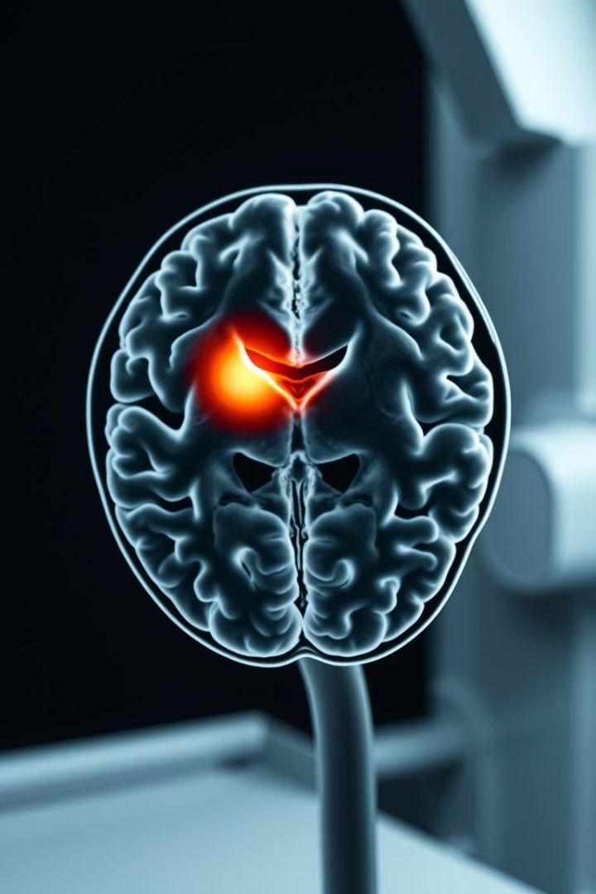
Ensemble Learning-Based System for Brain Cancer Diagnosis Using MRI Images
This presentation explores a precision-based approach to brain tumor diagnosis using MRI images and advanced machine learning techniques. Brain tumors, either malignant or benign, require accurate detection for effective treatment. Traditional manual analysis of MRI scans by radiologists can be challenging and prone to errors.
This study introduces a workflow utilizing tumor classification using deep learning models like EfficientNetB3, VGG16, ViT, and ResNet50 to improve diagnostic accuracy and efficiency.

Slide 2

Advances in Tumor Classification Using MRI Images
Image Enhancement
Attention Mechanisms
Pre-trained Models
Technologies like SRGAN and ESRGAN improve MRI image clarity, enabling finer feature extraction essential for tumor detection.
Vision Transformers (ViT) use self-attention to capture local and global tumor features, enhancing classification accuracy.
ViT and shape-scale awareness networks achieve high accuracy in tumor classification and 3D segmentation, improving clinical outcomes.

Slide 3
Dataset and Preprocessing for Brain Tumor Classification
Dataset Selection
Preprocessing
The Brain Tumor MRI Dataset contains 7,023 JPEG images across four classes: Glioma, Meningioma, Pituitary Tumor, and No Tumor.
Images are resized to 224×224 pixels and normalized to a 0-1 scale to ensure consistent input and faster model convergence.
Images are sourced from public datasets, providing diverse tumor sizes and morphologies for robust model training.
These steps improve accuracy and robustness in deep learning-based tumor classification.

Slide 4
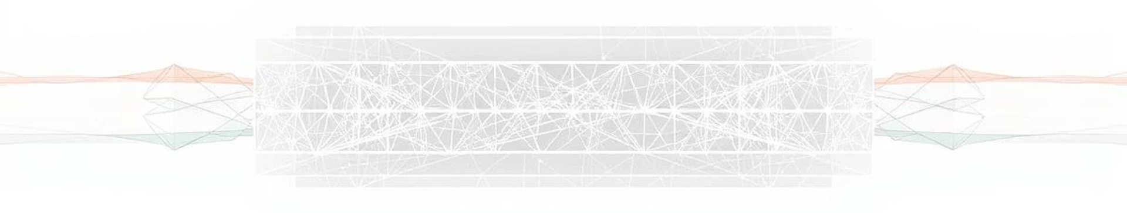


Deep Learning Models for Feature Extraction
EfficientNetB3
A CNN using compound scaling for balanced accuracy and efficiency, delivering high precision and fast inference for real-time applications.
VGG16 and VGG19
Deep CNNs with small convolutional filters capturing fine-grained features. VGG19 slightly outperforms VGG16 but is more computationally intensive.

Slide 5
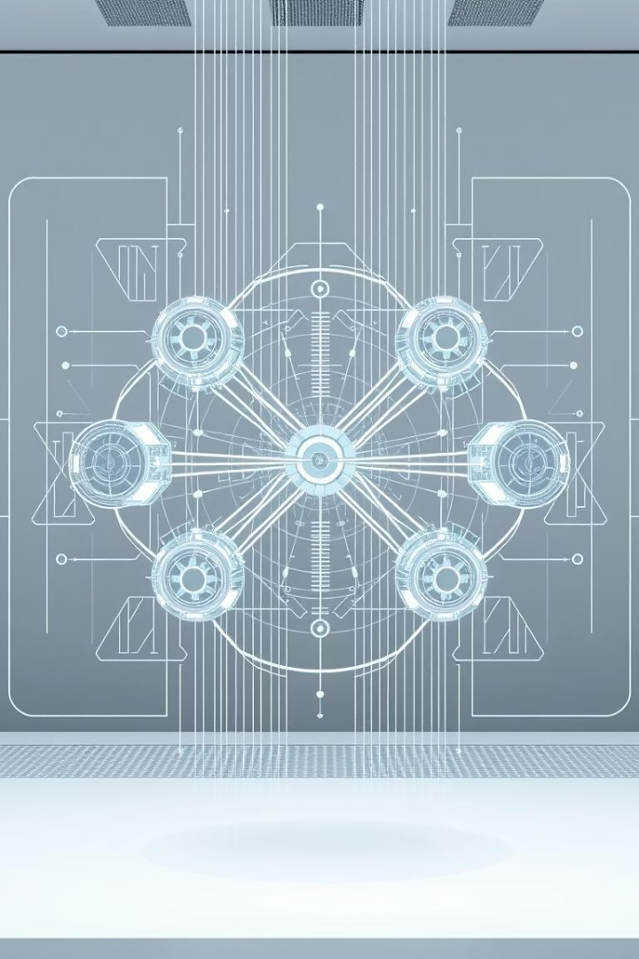
Ensemble Learning to Boost Classification Performance
Stacking Ensemble
Combines predictions from EfficientNetB3, VGG16, and VGG19 using a meta-model to improve accuracy and robustness.
Benefits
Mitigates individual model limitations, capturing diverse data patterns for enhanced generalization and reliability.

Slide 6
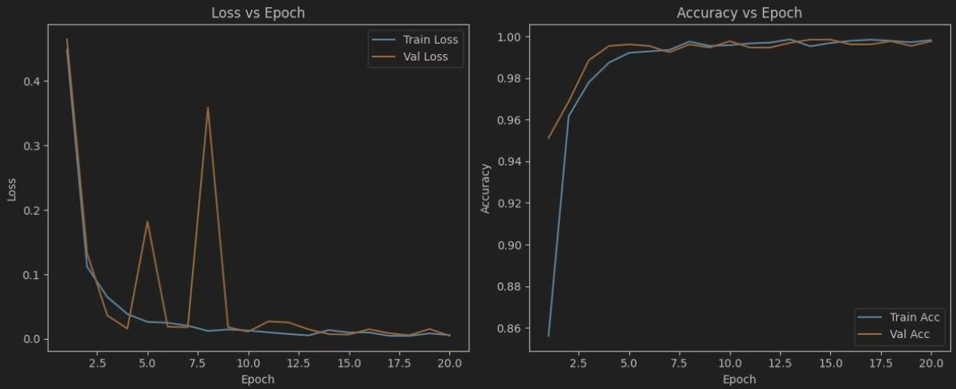
Model Performance and Results
EfficientNetB3
VGG Models
Ensemble Results
Achieved training accuracy of 99.82% and testing accuracy of 99.77%, outperforming other models.
VGG16 showed 98.91% training and 96.49% validation accuracy; VGG19 improved to 99.35% training and 98.86% validation accuracy.
The stacking ensemble reached 99.79% training and 99.39% validation accuracy, demonstrating enhanced classification performance.

Slide 7
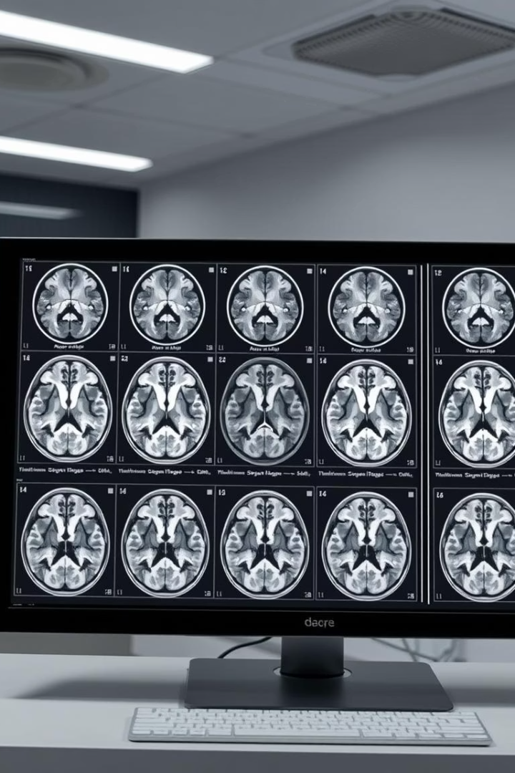
Future Directions: Content-Based Image Retrieval (CBIR)
Feature-Based Retrieval
CBIR systems store MRI features separately to retrieve similar cases, aiding clinicians in diagnostic decision-making.
Clustering Techniques
Algorithms like k-means cluster images to speed up retrieval, using distance metrics for accurate similarity matching.

Slide 8

Conclusion: Enhanced Brain Tumor Diagnosis with Ensemble Learning
This project presents a high-performance system optimized for common brain tumor types, combining image enhancement and ensemble deep learning models.
The approach delivers accurate tumor classification, supporting radiologists and oncologists in diagnosis and treatment planning, with potential for future integration of CBIR to further improve clinical outcomes.

